Slide 1

All Aboard: Navigating Public Transit Access in Chicago
A Spatial Analysis of Transit Equity in the Windy City
By: Sanika Gokakkar

Slide 2

Introduction
Why Transit Access Matters?
Public transportation is essential for economic opportunity, mobility, and equity
In cities like Chicago, access to transit is not distributed equally
This project explores who has access — and who’s left behind

Slide 3
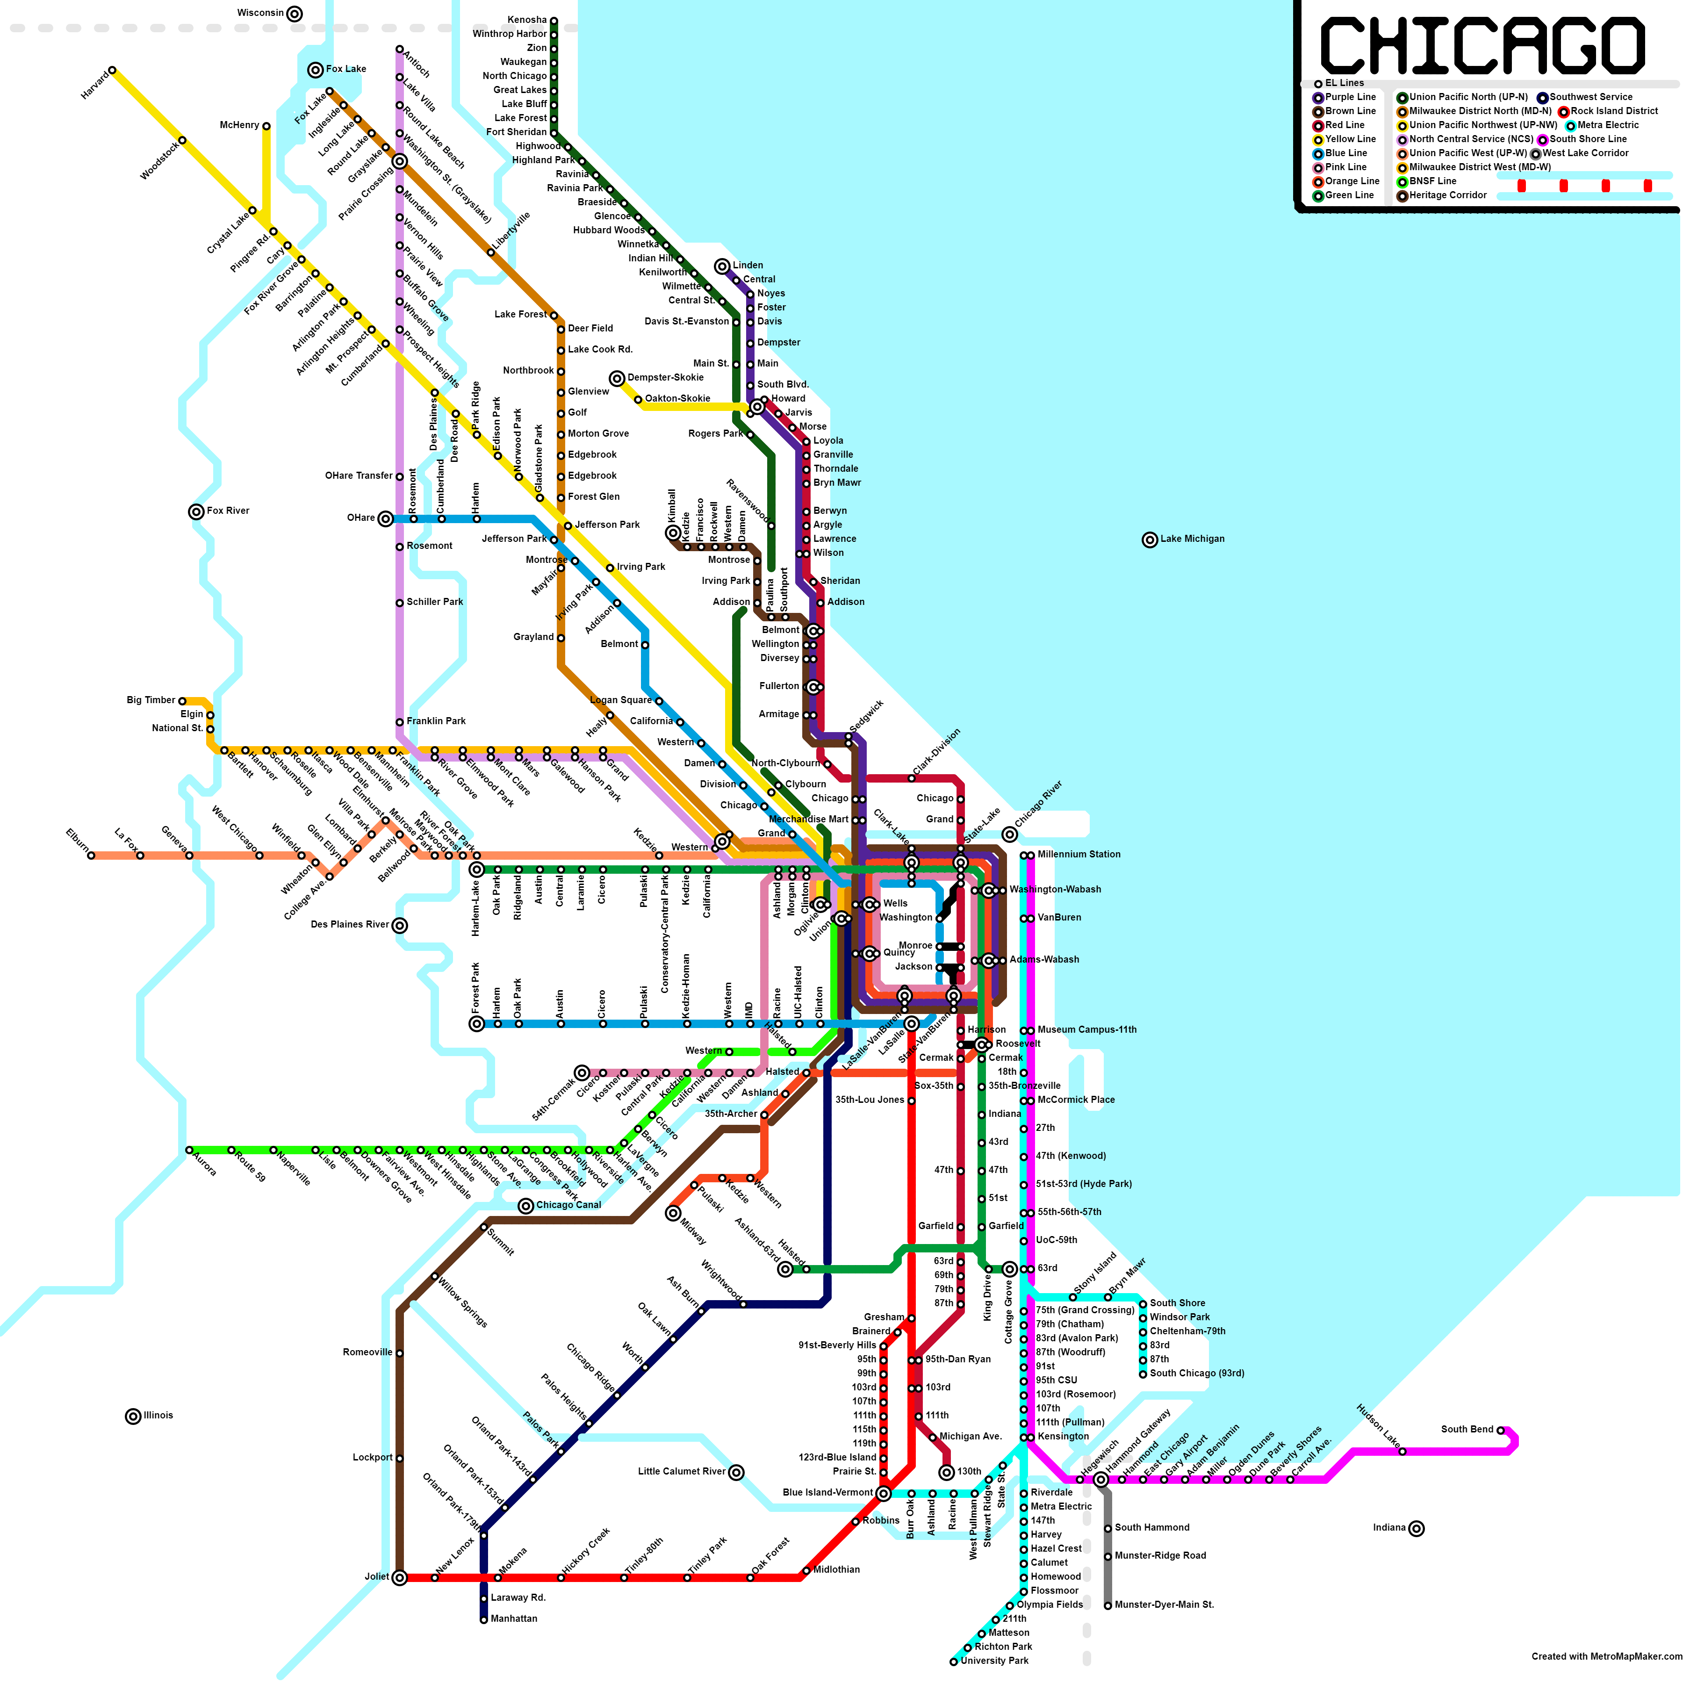
Project Goals
Map CTA train access across Chicago
Identify neighborhoods with limited transit service
Analyze links between transit access and demographic factors
Recommend strategies to promote equitable transit development

Slide 4
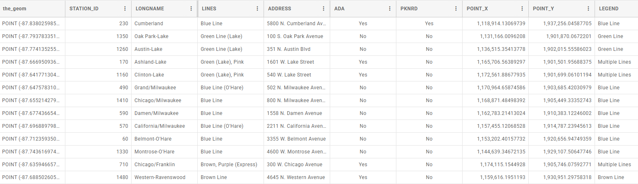
Tools & Data Sources
ArcGIS Story Maps: for interactive storytelling
CTA Data: train routes, stops, neighborhoods
U.S. Census Data: demographics (income, population density)
GIS Techniques: spatial joins, buffer analysis, and symbology

Slide 5
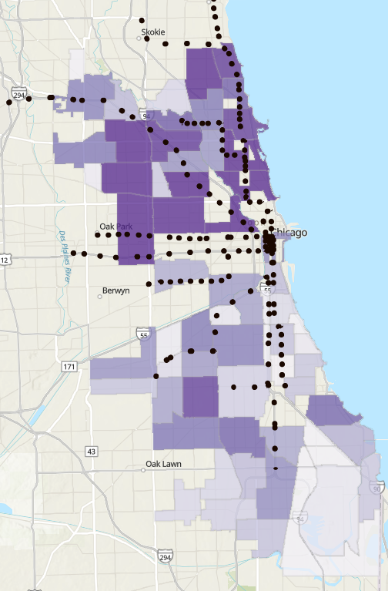
Mapping Transit Access
Transit is concentrated in the North Side and downtown
Higher frequency, more route options in wealthier neighborhoods
South and West Sides show gaps in coverage

Slide 6
Identifying Transit Deserts
Transit deserts = neighborhoods with few or no nearby CTA stops
These areas often overlap with low-income and minority communities
Limited mobility → fewer opportunities for work, school, healthcare

Slide 7
Key Takeaways
Chicago’s transit network is uneven
Service quality aligns with wealthier, central areas
Equity gaps persist in low-income neighborhoods
Data-driven maps reveal hidden patterns and inform better decisions

Slide 8
Recommendations
Building a More Equitable System
Expand transit services to underserved communities
Prioritize funding for South and West Side infrastructure
Involve residents in planning and decision-making
Use data and maps to guide future investments

Slide 9
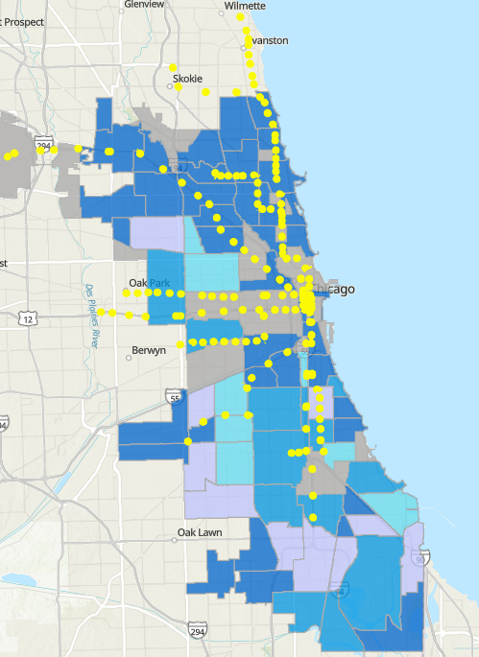
Final Thoughts
Mapping this data helped me understand the human impact of transit gaps
Equity in transportation = equity in opportunity
Tools like Story Maps help bridge data and storytelling
Link to my story map: https://storymaps.arcgis.com/stories/8dfe6de212414c4d8f9d61728bb356b4

Slide 10
THANK YOU!!!!!

